Slide 2
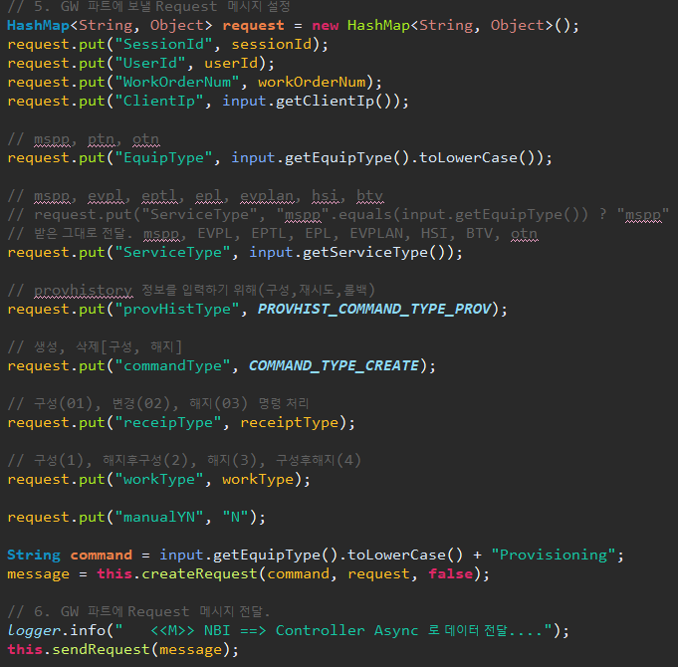


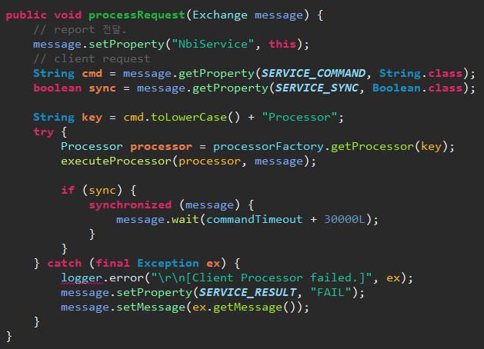


ProvisioningCommandRpcServiceImpl
NbiServiceAdapter
NbiServiceProcessor

